Slide 1
2020-21 Chapter Retreat
Programming Report
August 29, 2020

Slide 2
National Programs
Services to Youth
The Arts
National Trends & Services
International Trends & Services
Health & Human Services
National Mentoring Initiative
Young Achievers
Links to Success: Children Achieving Excellence Signature Program
National STEM Education and Career Readiness Initiative
National HBCU Initiative
Signature Arts Program: Classics Through the Ages
National Poster Art Competition
Partner in The Arts: The Sphinx Organization
Young Master Writers Program Competition
Ally Wallet Wise Financial Literacy Program
Project LEAD: High Expectations - Responding to the Drug Epidemic
AARP: Caregiving Across the Spectrum
Education Across the Miles Signature Program
LinksHelp for Humanity
Links International Foreign Affairs and Business Empowerment for Youth (LIFE)
The Links at the United Nations
Health Equity Ambassador Program
HeartLinks Signature Program
Linkages to Life
National HIV/AIDS Initiative
National Mental Health Initiative
National Oral Health Initiative

Slide 3
Central Area Priorities

Slide 4
Virtual Programming
What?
How?
The COVID-19 pandemic will eventually end, but it seems that virtual programming is only beginning:
  Establish/convert to virtual event format
  Develop master plan and schedule
  Time of day
  Frequency of the virtual activities
  Length of the activities
  Follow up
Know your audience – Design programs the community needs vs. what you want to do
If you can’t drive, provide!
Leverage technology with a personal touch - - - ENGAGE!
Testing, testing, 1-2-3
Stay safe and work within your personal comfort zone

Slide 5
CHAIR Presentations

Slide 6
Facet Chairs
National Trends & Services
Link Jacqueline Bridgeman
Health & Human Services
Link Yvonne Dias-Bowie
International Trends & Services
Link Leslye Hartsell
Link Tanisha Jenkins
The Arts
Link Sylvia Peters
Link Yolanda Childs
Services to Youth
Link Beverly Sligh
Link Brenda Anderson

Slide 7

A Moment of Silence, A Call to Action
Eric Garner
Trayvon Martin
Freddie Gray
Stephon Clark
Atatiana Jefferson
Mike Brown
Tamir Rice
Jordan Davis
George Floyd
Sandra Bland
Breonna Taylor
Botham Jean
Philando Castile
Walter Scott
Alton Sterling
Ahmad Aubrey
Jacob Blake

Slide 8




National Trends & Services
Chair: Link Jacqueline Bridgeman
2020-21 Budget: $1,000
Planning for 2020-21
L2: Black Lives Matter – A Call to Action
  To provide education, support, and advocacy to voters in all levels of elections- local, state, and federal, GOTV, Census 2020
  When We All Vote
  National Voter Registration Day
  September 22, 2020
  Links on the Hill
  Census 2020
Habitat For Humanity
Phyllis Wheatley YWCA
  Bullying: It’s No Joke
Human Trafficking
Wallet Wise – Ally Financial Services

Slide 9




Health & Human Services
Chair: Link Yvonne Dias-Bowie
2020-21 Budget: $1,000
Planning for 2020-21
Alzheimer’s Tennessee Sponsor
Howard Circle of Friends
Childhood Obesity Program
Annual Walks
  Annual Walk for Healthy Living
  Alzheimer’s Tennessee
  Susan G. Komen Race for the Cure
HHS Monthly Health Awareness Presentations & Calendar
  2020 Health Awareness Calendar
L3: The Links G.R.E.E.N. Initiative
  To educate and promote awareness around making healthy lifestyle choices for stronger communities
  South Knoxville Senior Center

Slide 10


International Trends & Services
Chair: Link Leslye Hartsell
Co-chair: Link Tanisha Jenkins
2020-21 Budget: $1,000
Planning for 2020-21
Links Pantry
  Provide supplies and/or donation of essential items to support women and families at Bridge Refugee Services, Inc. on a quarterly basis
  Provide toiletries, feminine products, diapers, coats, and items not provided via EBT in the name of our Chapter
L3: The Links G.R.E.E.N. Initiative
  To educate and promote awareness around making healthy lifestyle choices for stronger communities
  Basket Project Video
International Women’s Day
  March 5, 2021 - Celebrating Women’s Rights and Womanhood
  Host a chapter brunch or luncheon
“Passport to Learning” – An English to French Translation

Slide 11
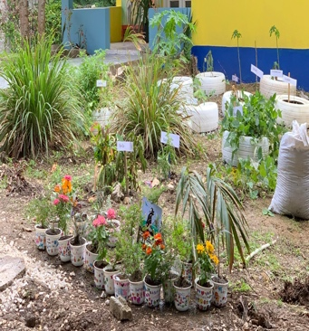


The Arts
Chair: Link Sylvia Peters
Co-chair: Link Yolanda Childs
2020-21 Budget: $1,000
Planning for 2020-21
L1: Garden for Wildlife/ WildSTEM
  To foster ethnic, gender, and cultural diversity in the world of technology
  ZOOM facilitation of wildlife gardens during COVID-19 at schools and/or community centers (in person post COVID-19)
  WildSTEM Educational Programming
Pottery, Posters, and Poetry
  Pottery: Workshop on making plates and displaying at an art venue
  Posters: National Poster Art Competition
  Poetry: Young Master Writers Competition Program
    Young people channeling their experiences, observations, fears, and hopes into works of expressive, original prose and poetry
Notes:
1. Wildlife/WildSTEM – Promoting The Links, Incorporated and the National Wildlife Federation (NWF) partnership with a goal of uniting all Americans to ensure wildlife thrive in a rapidly changing world. Beautification projects that educate and inspire the next generation of environmental stewards.

Slide 12



Services To Youth
Chair: Link Beverly Sligh
Co-chair: Link Brenda Anderson
2020-21 Budget: $1,000
Planning for 2020-21
Support College and Career Day(s) at Vine Middle School, Austin East High School and other schools in the area
Work with West View Elementary School educators by providing materials and supplies for their students
L1: Assist, collaborate and participate with Vine Middle School National Society of Black Engineers (NSBE) Jr. Chapter Program
  To foster ethnic, gender, and cultural diversity in the world of technology
Establish partnership and participate with Knox Education Foundation – Virtual Tutor Program

Slide 13
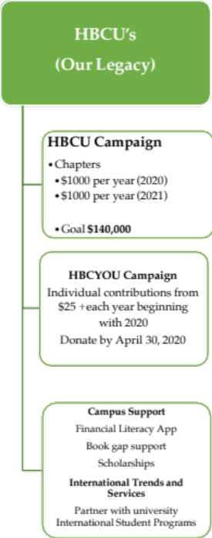






HBCUs – Our Legacy
Chair: Link Sandra Cannon
2020-21 Budget: $1,000
2020-21 Planning
Support HBCU Campaign - $1,000 donation
Build a family legacy board
Host a virtual pep rally –
  Equipped with gear, school songs/chants and throwback pictures
Spill the Tea - What My HBCU Means to Me
  A virtual tea to reminisce, connect and execute a donation campaign
Mentor and recruit students to attend and graduated from HBCUs
Promote and encourage a connection with an HBCU and its STEM programs

Slide 14
UMBRELLA PROGRAM PROPOSAL

Slide 15

Aviation Camp Proposal
Summary Proposal: June
    WHO: Metropolitan Knoxville Airport Authority
    WHAT: Embarking on an ”Aviation Camp" for youths
        To expose, and hopefully, attract area youth to all aspects of aviation including piloting, maintenance, mechanics, operations, and administration
        Lecture series and highly-interactive activities, with speakers from every area of the aviation field; will look for minority speakers as well
        Partnership: Include other businesses/institutions, much like The Delaney Project
    WHEN: 2020-21 Link Program Year & Camp in Summer 2021
        Idea phase but MKAA is giving the Chapter first mover advantage
    WHERE: Camp will be held at approved sites at the airport; participants will need to be transported
    WHY:
        Design innovative program series leading up to the Aviation Camp
        Identify pipeline of students directly from our programs and participating schools
        Brand recognition and increased visibility within the community and among employers

Slide 16


Goodness of Fit?
Illustrative
L1
L2
L3
NTS
STY
ITS
HHS
Arts
My
Mask
Save
to
Play
Just
Plane
Food
NSBE-Jr
Activity
Poster
Contest
Walk
Runway
Mdm
Butterfly
HBCYou
Pilot
My
Passport

Slide 17
Aviation Camp Proposal
Next Steps
Follow-up meeting with Program Facet Chairs to determine program interest, viability, and alignment with current plans for 2020-21
Present motion to the Chapter for support and approval to move forward with the initiative as an Umbrella Program
If approved, accelerate planning to determine:
  How our programming can be a pipeline to the Aviation Camp which is planned for summer 2021
  How to identify students from the schools we currently support - Vine, Austin East, Fulton, and West View

Slide 18

Next Steps
Schedule next meeting with Facet Chairs
Identify opportunities to coordinate L3 initiatives across Facets
Refine Service Delivery Model
Build a calendar of events to be posted on the website & in Track It Forward

Slide 20
Service Delivery Model
Situation (The Problem) |  | Priorities |  | Mission/Vision (What drives the outcome?)
Inputs | Outputs |  | Outcomes
Resources | Activities | Participation | Short-Term | Mid-Term | Impact/Long-Term
In order to accomplish our | In order to address our | We must clearly identify | If accomplished, we expect | If accomplished, we expect | If accomplished, we expect
set of activities we will | problem, we will | the groups we are serving. | these activities will lead to | these activities will lead to | these activities will lead to
need the following: | accomplish the following |  | the following changes in 1- | the following changes in 3- | long-term societal
 | activities: |  | 2 years: | 4 years: | changes.
1. | 1. | 1. | 1. | 1. | 1.
2. | 2. | 2. | 2. | 2. | 2.
3. | 3. | 3 | 3 | 3 | 3
4. | 4. | 4. | 4. | 4. | 4.
Assumptions 1. 2. |  |  | External Factors (Things that might negatively impact your program – i.e. environment, community, public policy) 1. 2.
Evaluation
What do you want to know? |  |  | How will you know it?

