Slide 1
Organizational Effectiveness Committee Presentation
Knoxville (TN) Chapter Retreat
August 29, 2020

Slide 2

Organizational Effectiveness
Organizational Effectiveness (O.E.) is the efficiency with which an organization meets its goals and objectives.
For The Links, Incorporated, O.E. is an intentional effort to meet goals by:
  Strengthening the bonds of friendship
  Improving operations
  Building service capacity
  Minimize and mitigate problems
Membership
Strategic Planning
Ethics & Standards
Organizational Effectiveness
Mind, Body, & Spirit
Social
Membership

Slide 3
WHY IS O.E. IMPORTANT?
Supports chapter leadership in building a positive organizational climate
Helps members communicate openly and honestly with each other
Encourages members to respect and honor one another
Allows members to appreciate each others’ differences, e.g. age, style, skills, background, etc.

Slide 4
WHY IS O.E. IMPORTANT?
Facilitates members’ alignment to organizational goals and policies
Helps members to work through conflict
Dismantles intergenerational barriers that block effective working relationships

Slide 5
WHY IS O.E. IMPORTANT?
Creates an opportunity to address:
Members forming dysfunctional cliques and factions
Members not showing support or loyalty toward one another
Members holding “meetings after the meeting”
Members talking or not listening, while someone else has the floor

Slide 6

Establish Chapter O. E. Baseline

Slide 7
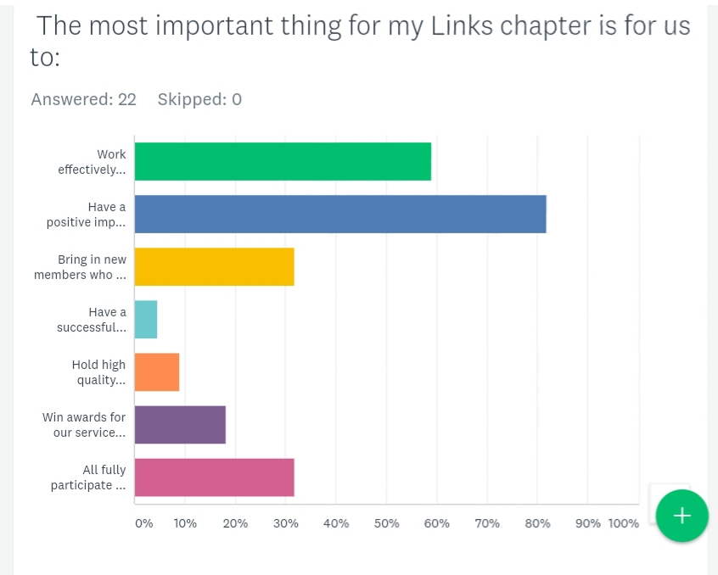
Question 1

Slide 8
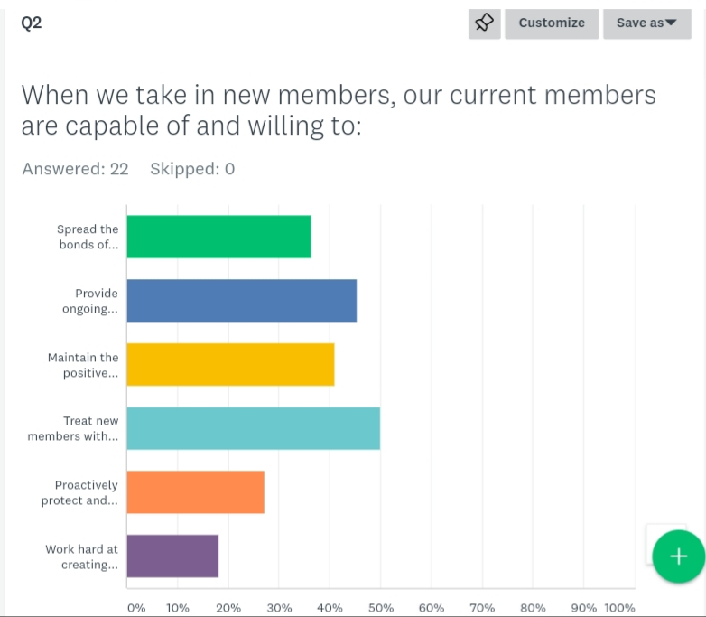
Question 2

Slide 9
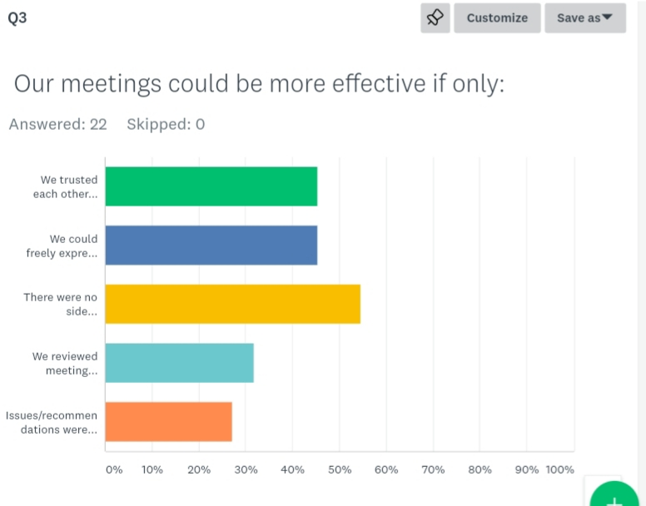
Question 3

Slide 10
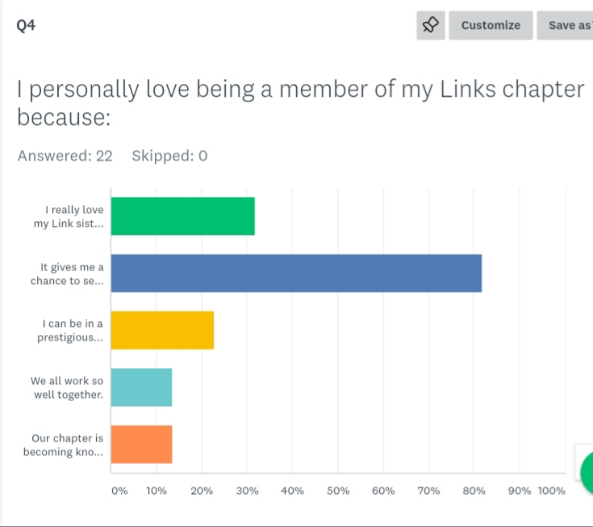
Question 4

Slide 11
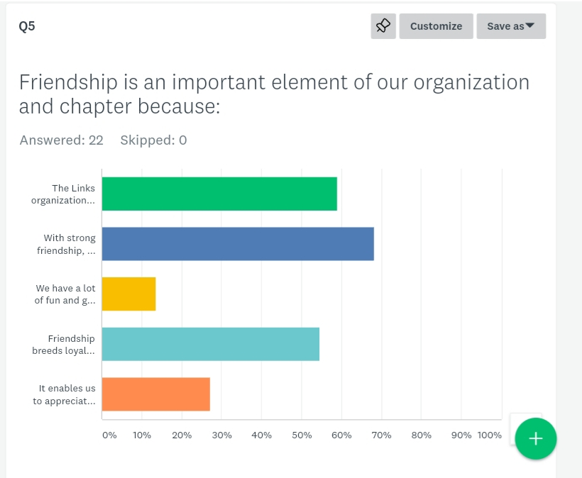
Question 5

Slide 12
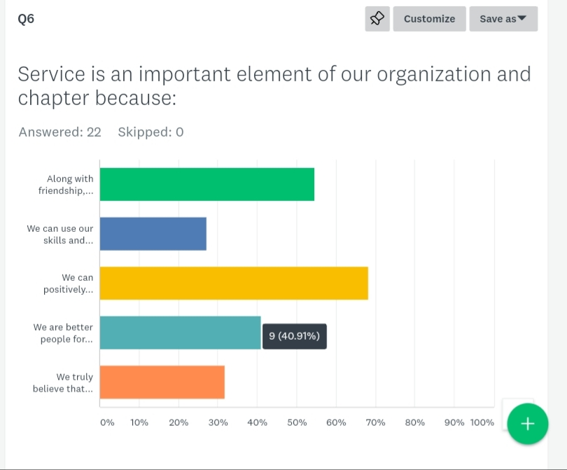
Question 6

Slide 13
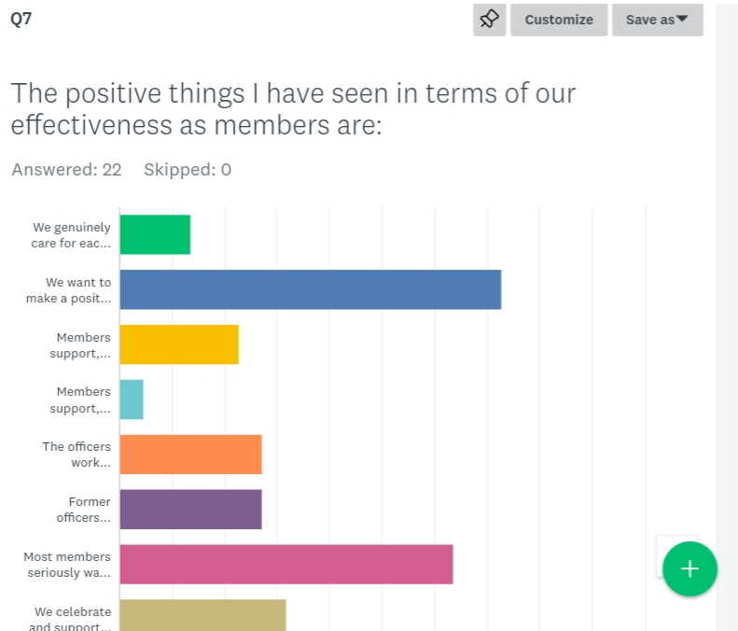
Question 7 (#1)

Slide 14
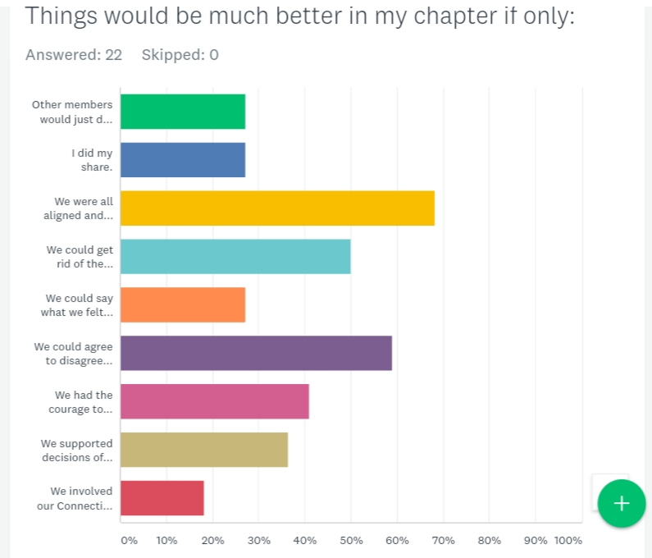
Question 7 (#2)

Slide 15
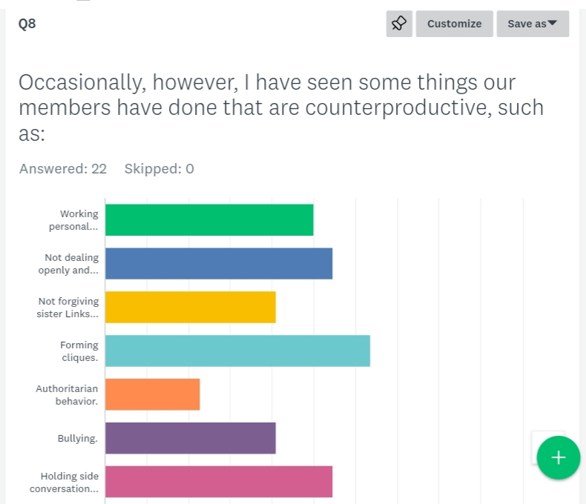
Question 8 (#1)

Slide 16
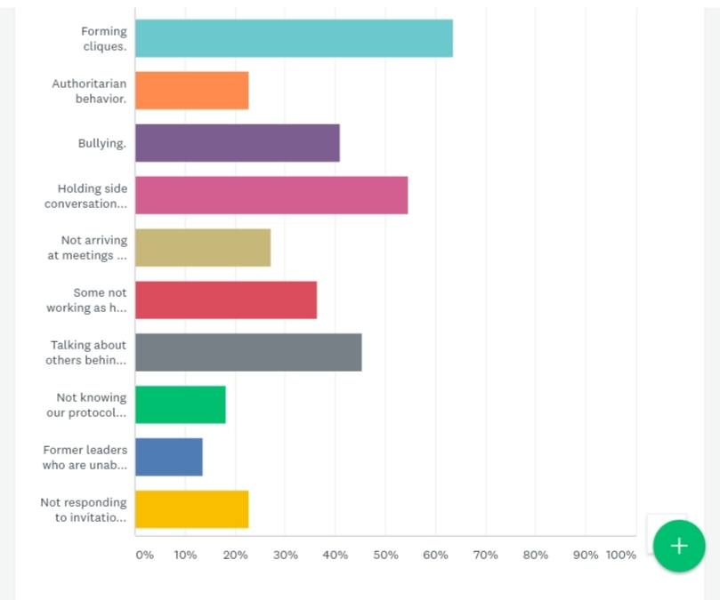
Question 8 (#2)

Slide 17
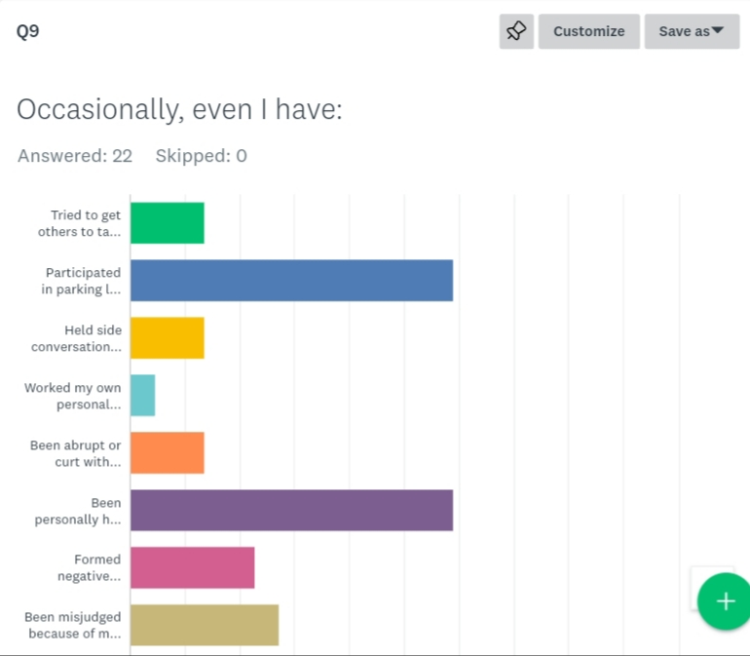
Question 9 (#1)

Slide 18
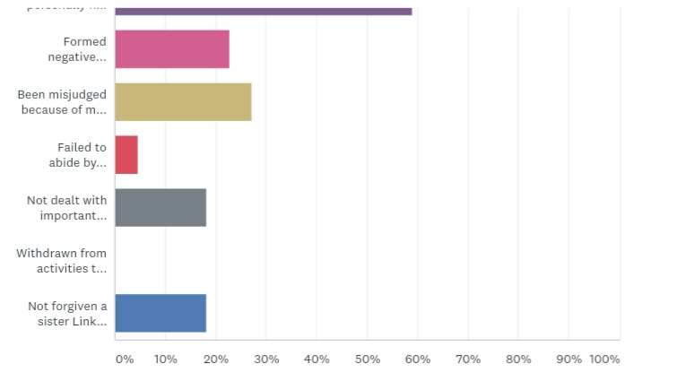
Question 9 (#2)

Slide 19
Question 10

Slide 20
NEXT STEPS
O.E. Committee will:
Review survey results
Prepare and deliver chapter trainings
Utilize team building techniques to enhance our chapter relationships

Slide 21
Organizational Effectiveness Committee
Link Avice Evans Reid (Chair)
Link Yvonne Dias-Bowie
Link Sandra Cannon
Link Gloria Deathridge
Link Brittany Gardner
Link Leslye Hartsell
Link Wanda Jones
Link Jan Brown,
Chapter President (Ex-Officio)

